Slide 1
[Insert Higher Education Institution (HEI) name here]
[Insert HEI logo here]
[Insert HEI website, email, socials here]
Notes:
(internal)
Presentation Goal
To attract top-tier high school students from mathematics and informatics profiles who are passionate about technology, mathematics, physics, IT, and programming. We are looking for future students who are driven and understand what lies ahead: a top-tier, rigorous faculty with significant challenges, but with rewards to match, offering exceptional career growth opportunities in research, industry, corporate environments, or starting their own tech ventures.
Presentation Notes
Timing: Target 30-35 minutes for the presentation to allow sufficient time for Q&A.
Speakers: Preferably, the presentation should be split between 1-2 professors and a maximum of 2-3 students; otherwise, it becomes difficult for the audience to follow.
Adaptability: The presentation is quite long. Adapt the content to the audience; it is not recommended to strictly cover every single slide and note. In its "maximum" version, it can run up to 45 minutes, so please watch the clock! :)
Interactivity: Insert as many questions as possible:
Open-ended: "Who can give me an example/definition?", "What do you think X means?", "How do you perceive X?"
Polling/Voting: "Who believes X or Y?", "Who wants X or Y?" (In online sessions, ask them to use the "raise hand" feature).
Key Pillars (Core Messaging)
We emphasize several recurring themes throughout the presentation:
A top-tier, rigorous HEI: It is challenging, but the rewards are proportional to the effort.
An elite community: Students will join a high-level peer group with similar interests, guided by highly prepared faculty members who are accessible and supportive.
Future Prospects: For those who take their studies seriously, there are excellent opportunities upon graduation in research, industry, corporations, or tech startups.
Internal Opportunities: Numerous ways to get involved during faculty years (student communities, volunteering, technical/entrepreneurship competitions, and faculty-led projects).
Recommendation: Assign one professor or student to act as a moderator to manage transitions and flow.

Slide 2
Presentation team
Name 1
Name 2
Name 3
Name 4
Notes:
//the people presenting this ppt: 1-2 minutes on this slide
! This slide should always be updated
Recommendation:
- 1-2 teachers/teaching assistants + 3-4 students

Slide 3

INTRO High School → HEI
Notes:
Purpose of this part: introducing the differences between highschool and HEI; highlight why is it important to pick an institution with a strong community
Every HEI should define here what are the main differences (in their country/region) between highschool and HEIs.

Slide 4
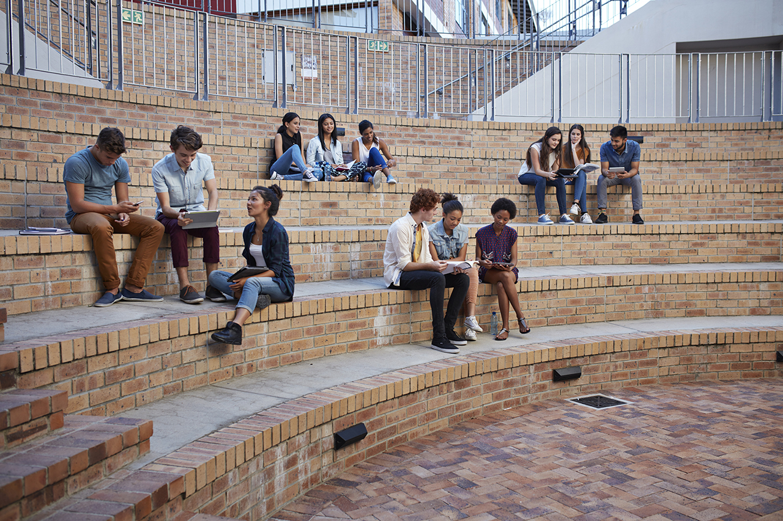
SAMPLE
Notes:
Insert an actual image from a course from your HEI
General ideas:
Sometimes classes and courses are taught by teachers to more than 100 students – extremely different than highschool classes
The teacher has a different approach in university than in a HEI

Slide 5
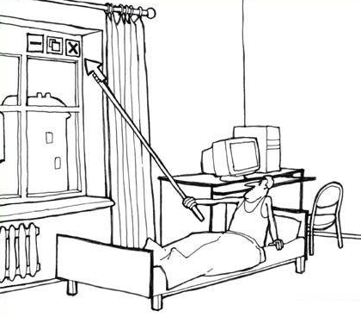
Welcome to <insert HEI name>
4
ENGINEER
Notes:
//presenter: teacher or student
You should present here:
What will your students become after graduation (e.g., engineer, software developer, system architect, etc.)
How many years does it take to graduate
Discuss what is a good engineer, a good software developer, a good system architect, etc.

Slide 6

Faculty/School Name

Slide 7












Automatic control
Video & Audio processing
Robotics
Medtech
Factory automatization
Machine
Learning
Transport automation
WebDesign
Hardware
Design
Data
Acquisition
Embedded
Programming
Data Base
Notes:
//presenter: teacher
Duplicate this slide as needed. In this slide you should insert icons that highlight the main subjects that your HEI/faculty has.

Slide 8







Internet
of Things
Machine
Learning
Computer
Networking
Operating
Systems
Computer graphics
Cyber
Security
Cloud & Big Data
Data Base
Robotics
Embedded
Programming
WebDesign
RPA
Notes:
//presenter: teacher
Duplicate this slide as needed. In this slide you should insert icons that highlight the main subjects that your HEI/faculty has.

Slide 9

Not just “programming”
Notes:
//presenter: teacher
In this section we should be presenting a project that future graduates will be able to implement. It is important to higlight that when getting a job they will work as a team, not individually.

Slide 10
[Showcase of real-life systems where the topics that students learn in the institution are applied]
[How to customize:
Present real-life systems and describe how the things that students learn in the institution can lead to the implementation of such large-scale systems.
Extra tip: Provide examples of real-world applications of each specialization (e.g., cybersecurity in protecting online transactions).]
Notes:
//presenter: teacher or student

Slide 11
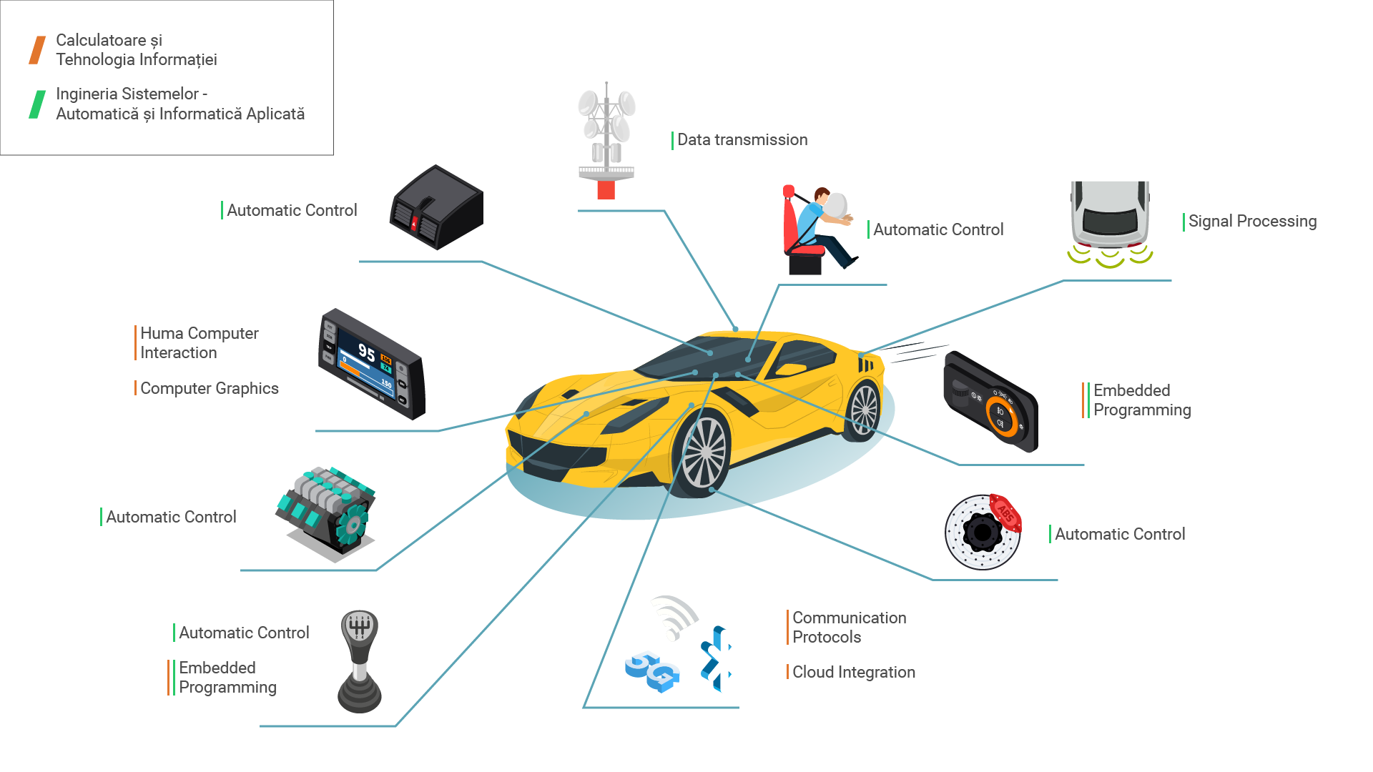
SAMPLE
Notes:
//presenter: teacher or student
This is just an example from Politehnica Bucharest.

Slide 12
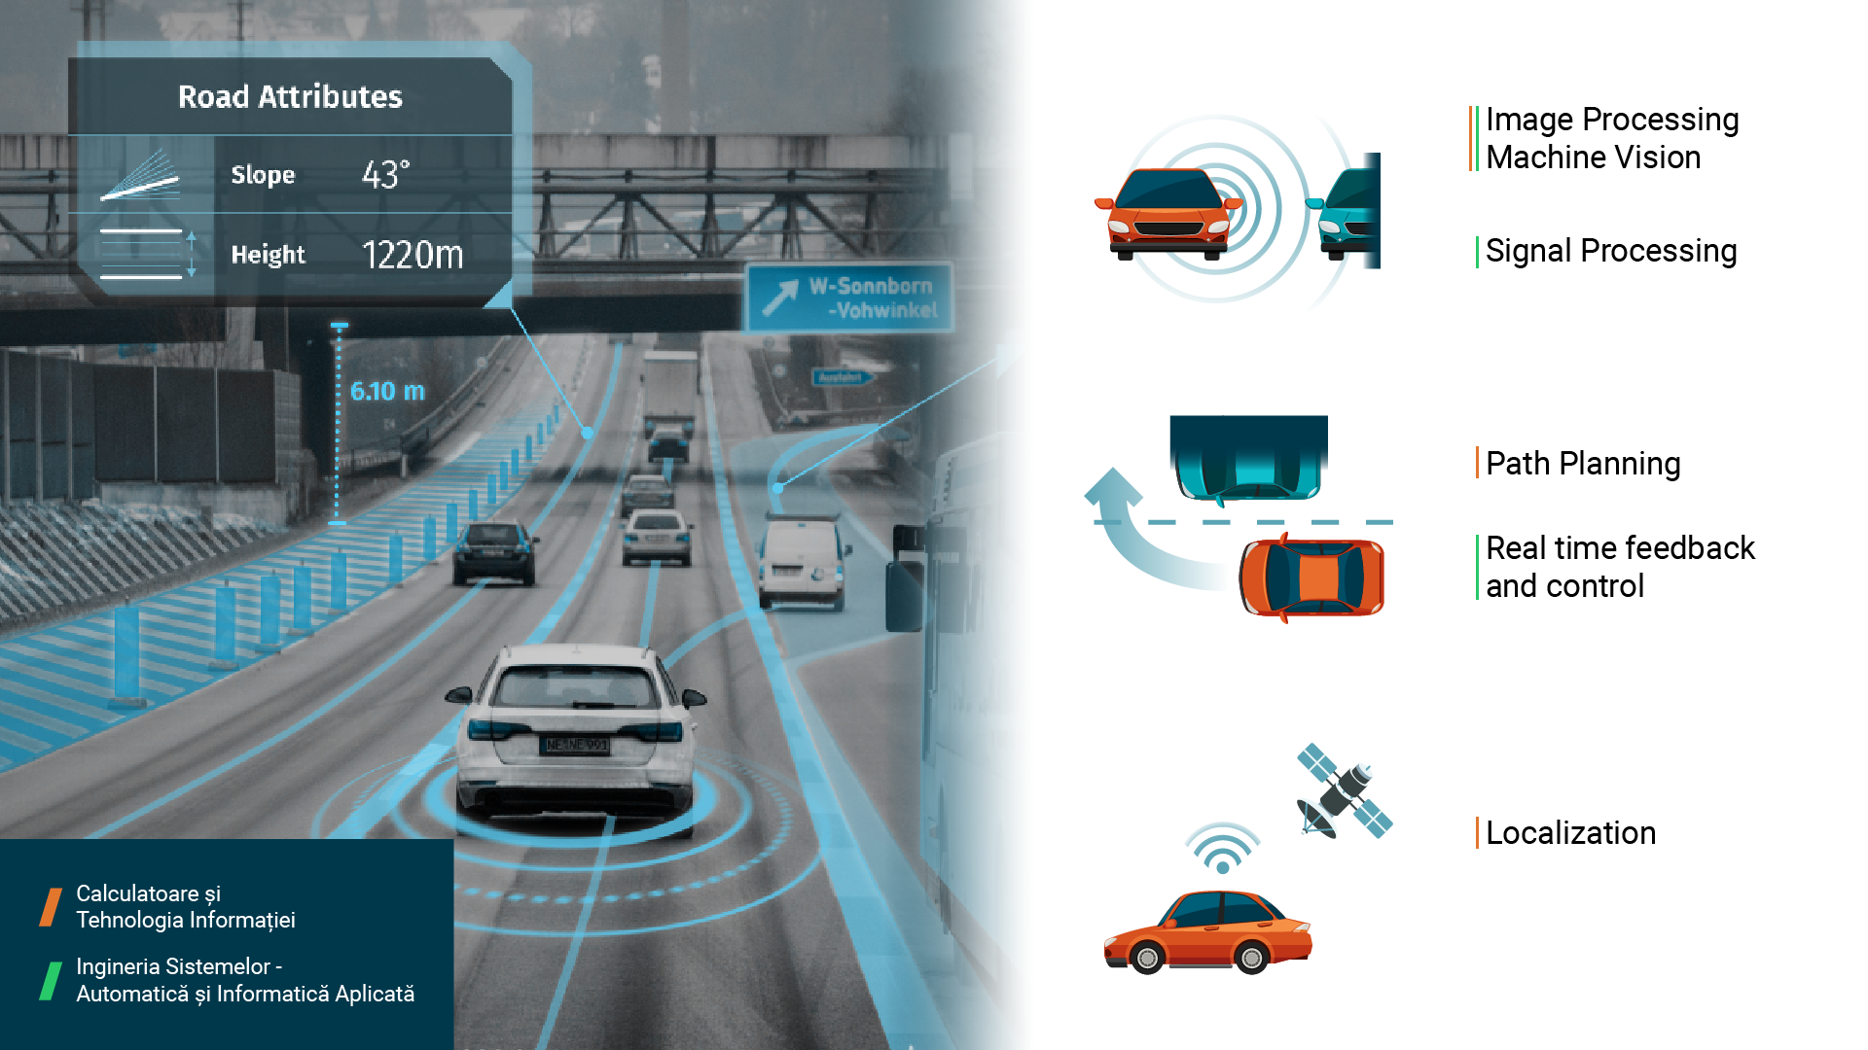
SAMPLE
Notes:
//presenter: teacher or student
This is just an example from Politehnica Bucharest.

Slide 13
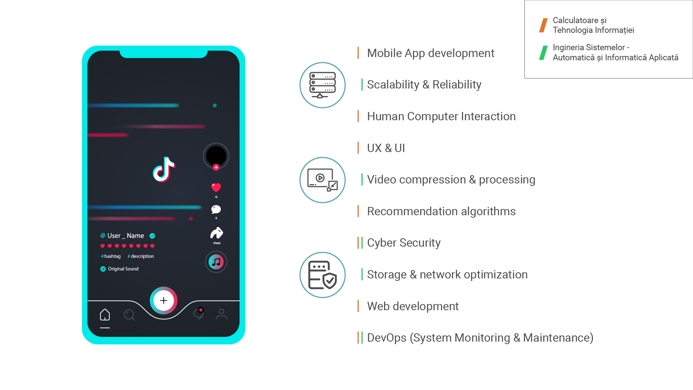
SAMPLE
Notes:
//presenter: teacher or student
This is just an example from Politehnica Bucharest.

Slide 14
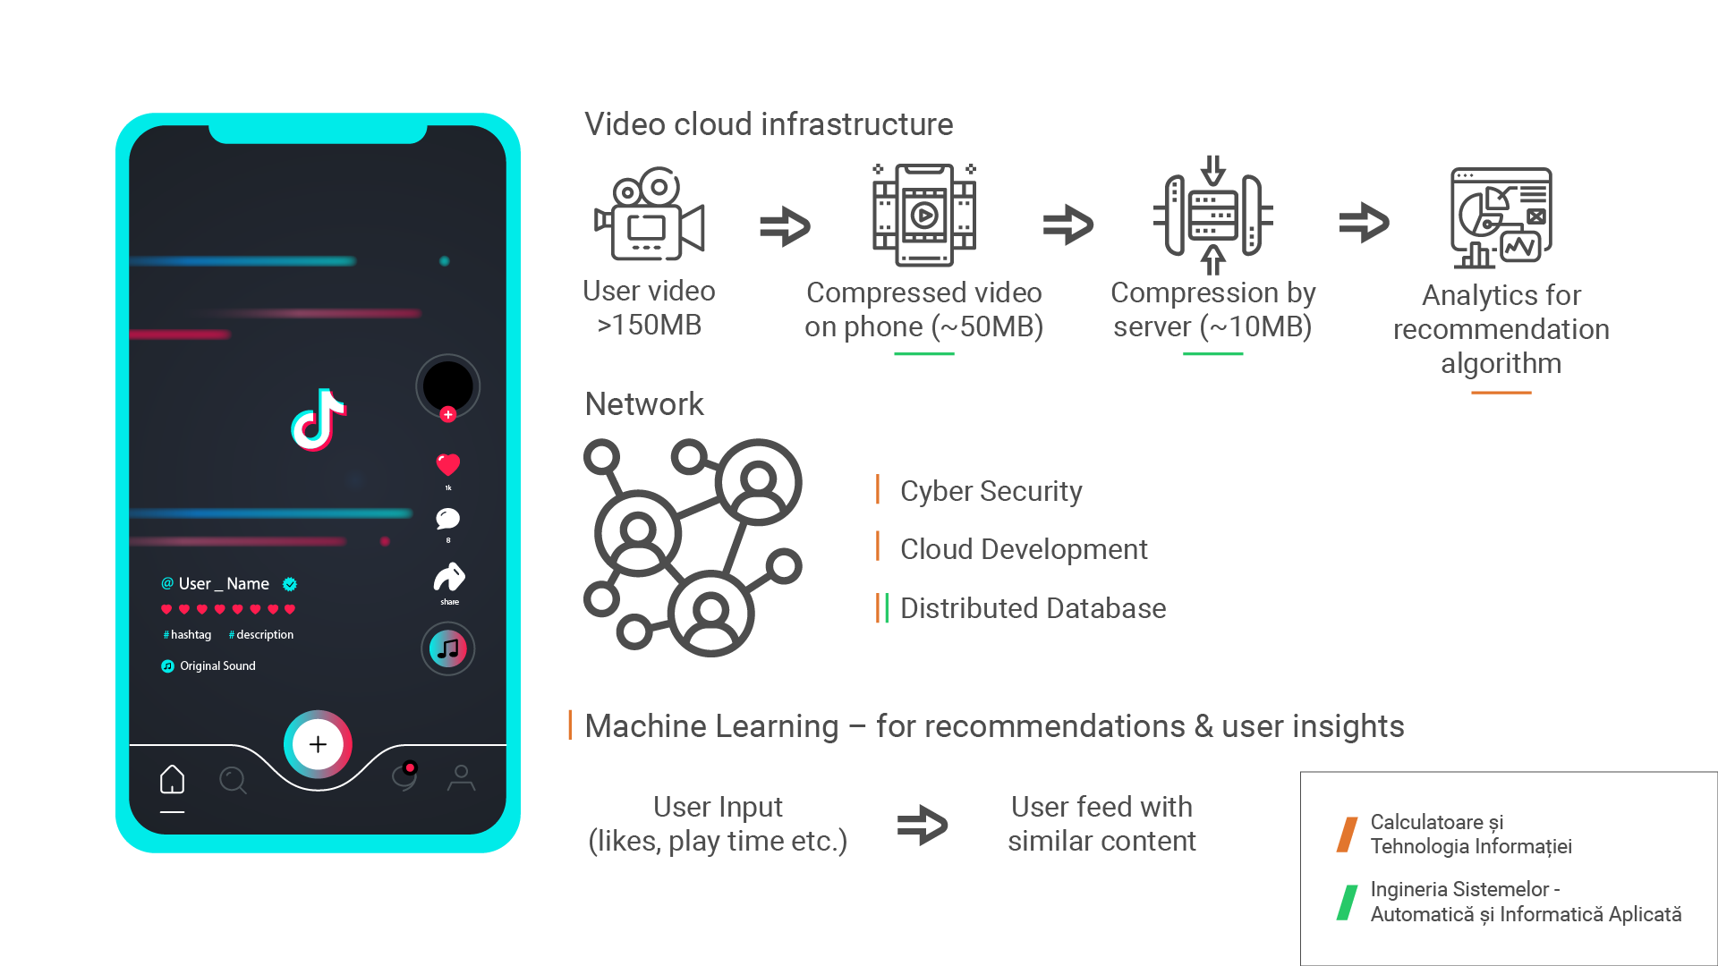
SAMPLE
Notes:
//presenter: teacher or student
This is just an example from Politehnica Bucharest.

Slide 15
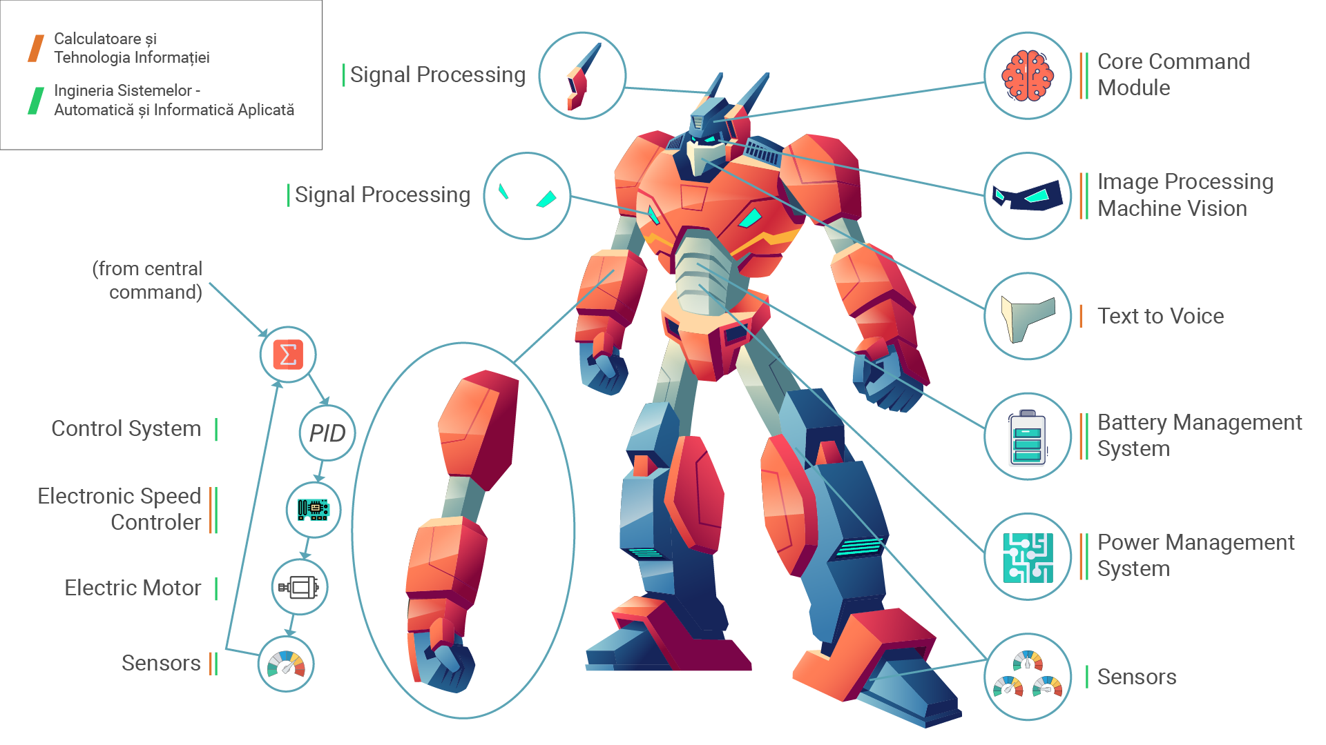
SAMPLE
Notes:
//presenter: teacher or student
This is just an example from Politehnica Bucharest.

Slide 16
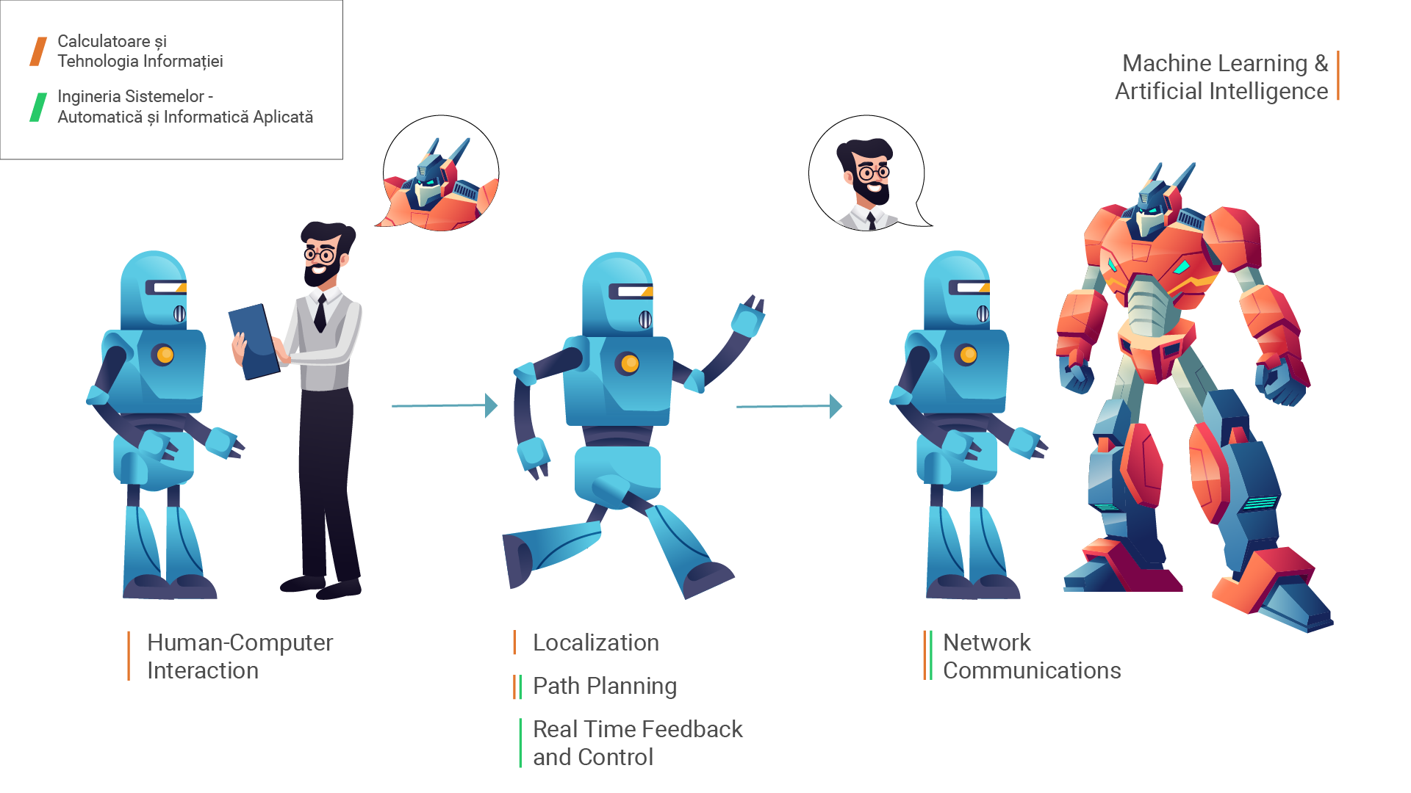
SAMPLE
Notes:
//presenter: teacher or student
This is just an example from Politehnica Bucharest.

Slide 17
Opportunities
Notes:
//presenter: student
A HEI does not only mean lectures, laboratories, homework, and exams. These are the basic building blocks, but beyond them, we have: - Community - Opportunities for community involvement and participation in numerous activities.

Slide 18



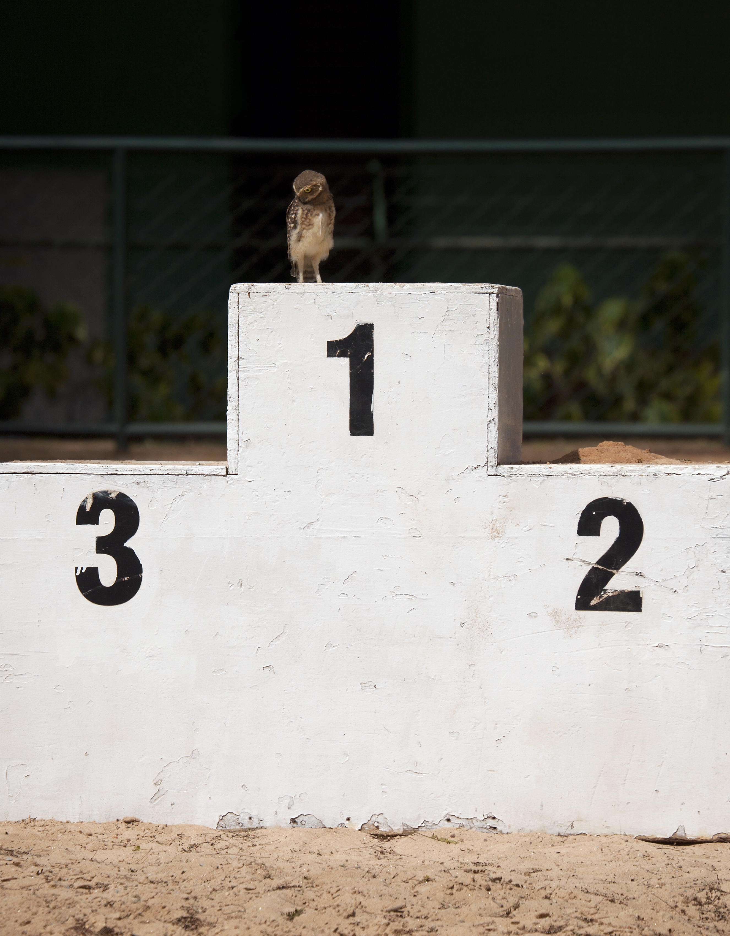
Competitions
examples
examples
Notes:
//presenter: student
Insert relevant pictures from competitions and/or hackathons that are being organized in your HEI
Duplicate as needed

Slide 19
examples
Summer Schools
Notes:
//presenter: student
Insert relevant pictures from summer schools and/or internships
Duplicate as needed

Slide 20
SAMPLE
Mobility
Notes:
Logo and graphics: Wikimedia Commons
//presenter: student
Insert map of Erasmus mobilities available in your HEI

Slide 21
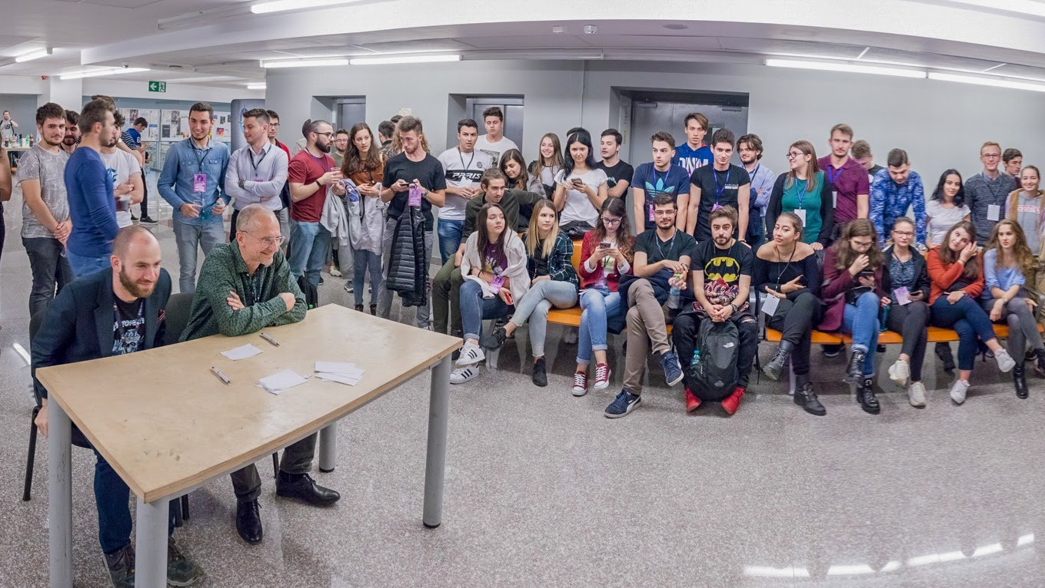
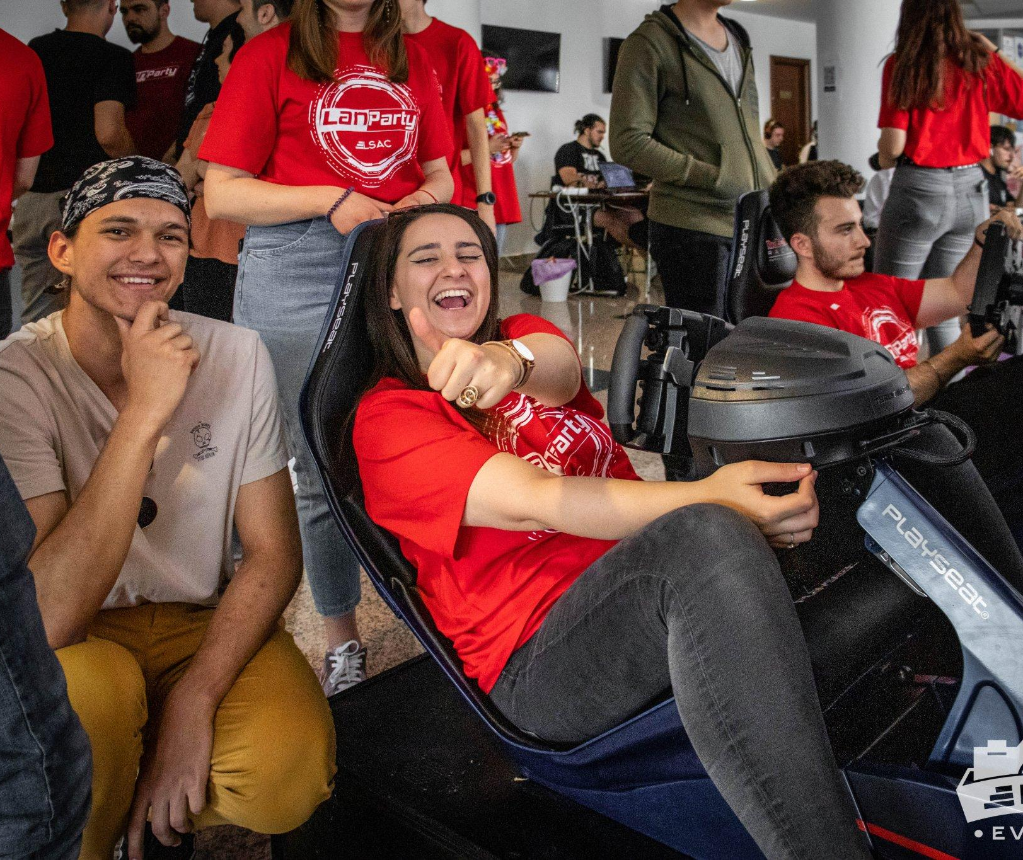
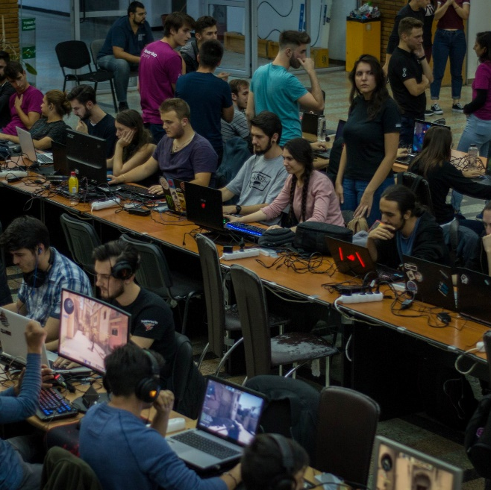
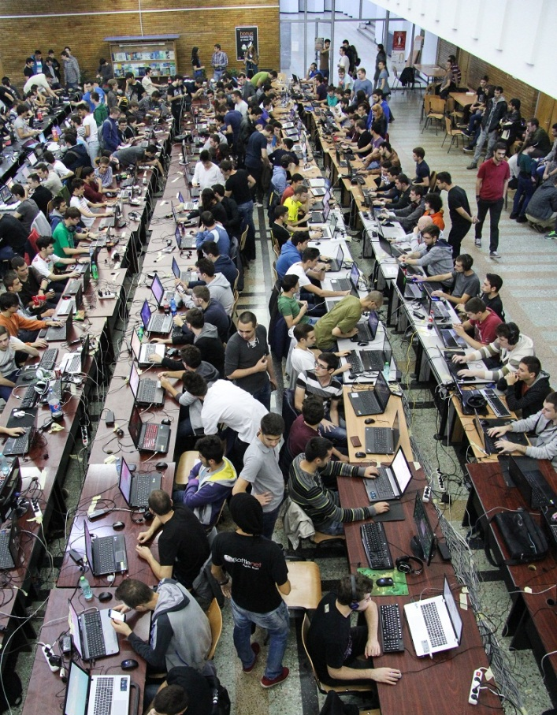
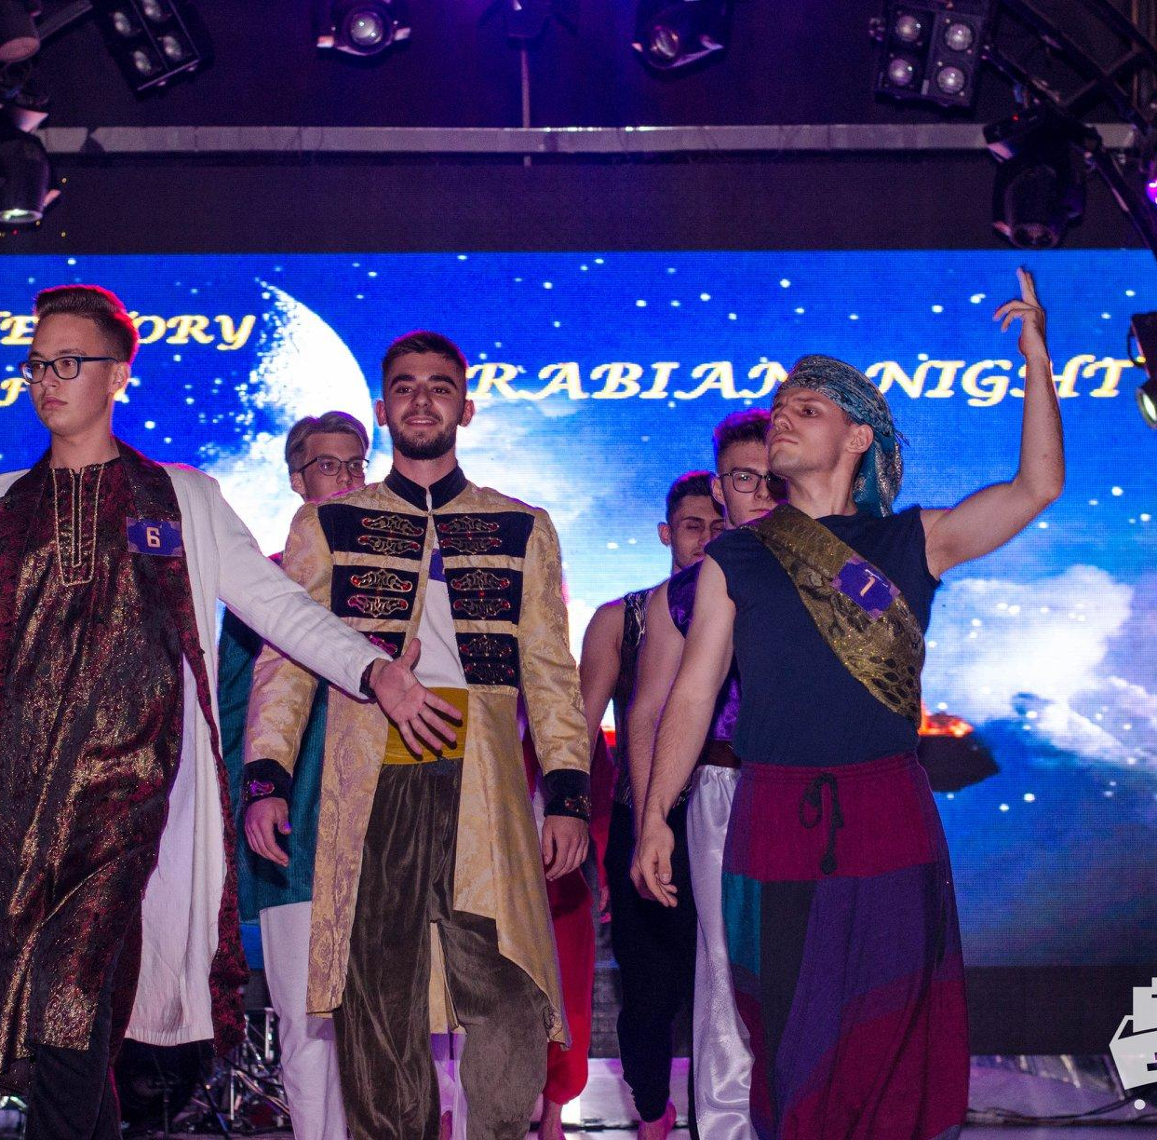
SAMPLE
Fun activities
Notes:
//presenter: student
Insert relevant pictures from fun activities that are being organized in your HEI
Duplicate as needed
The highlight should be on community

Slide 22
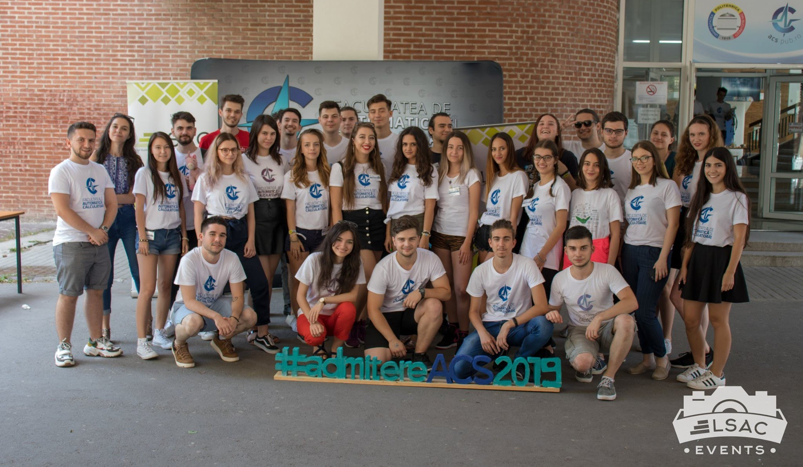
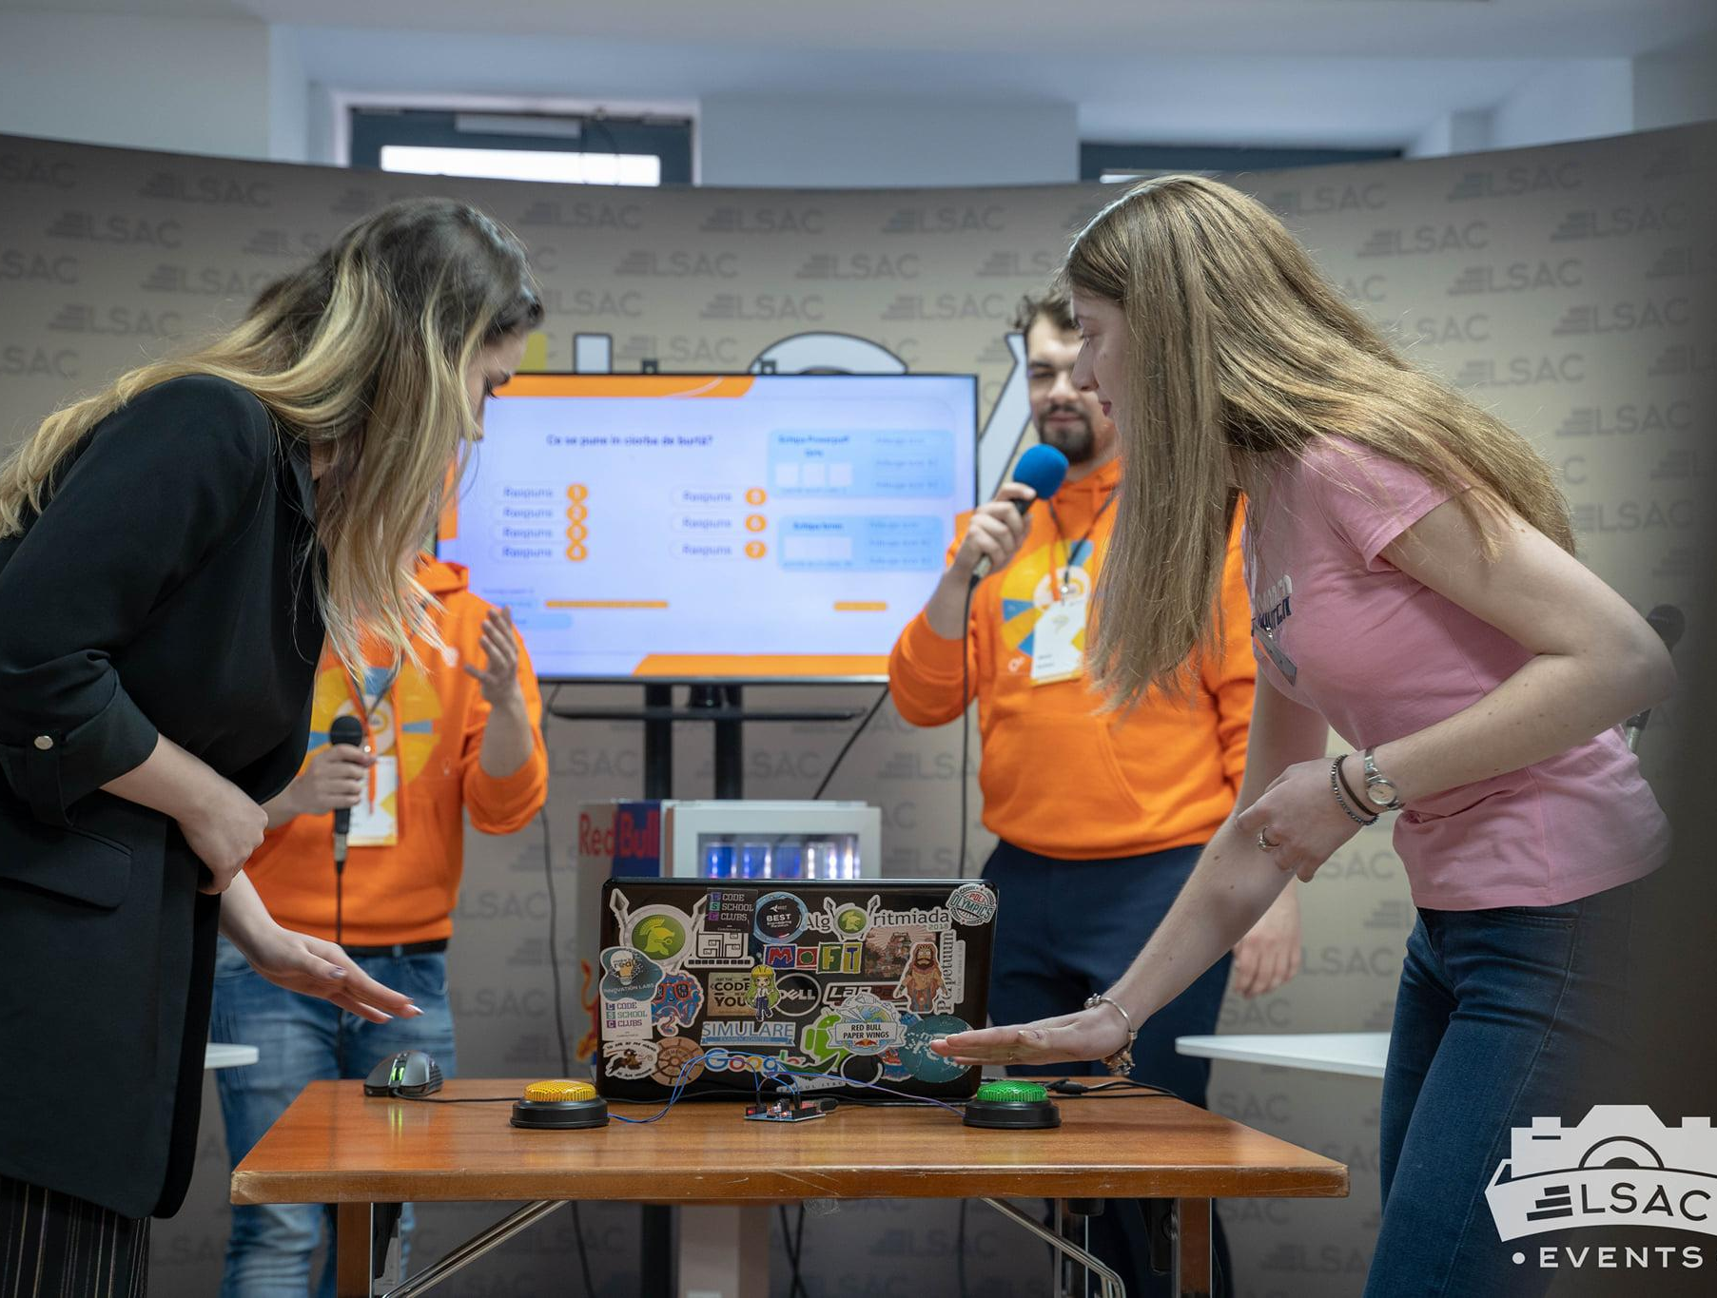
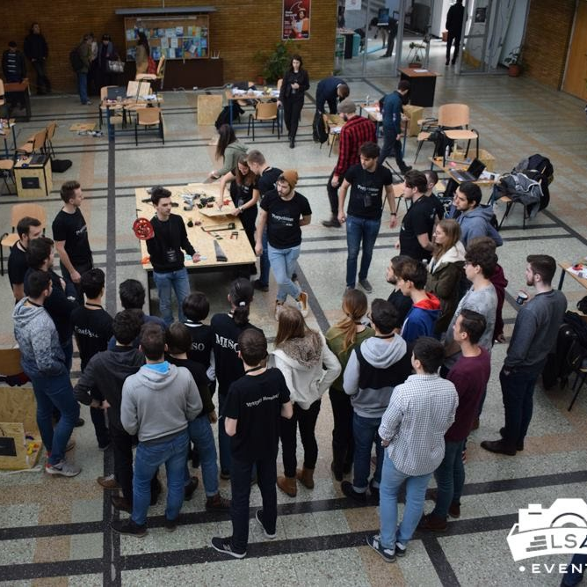
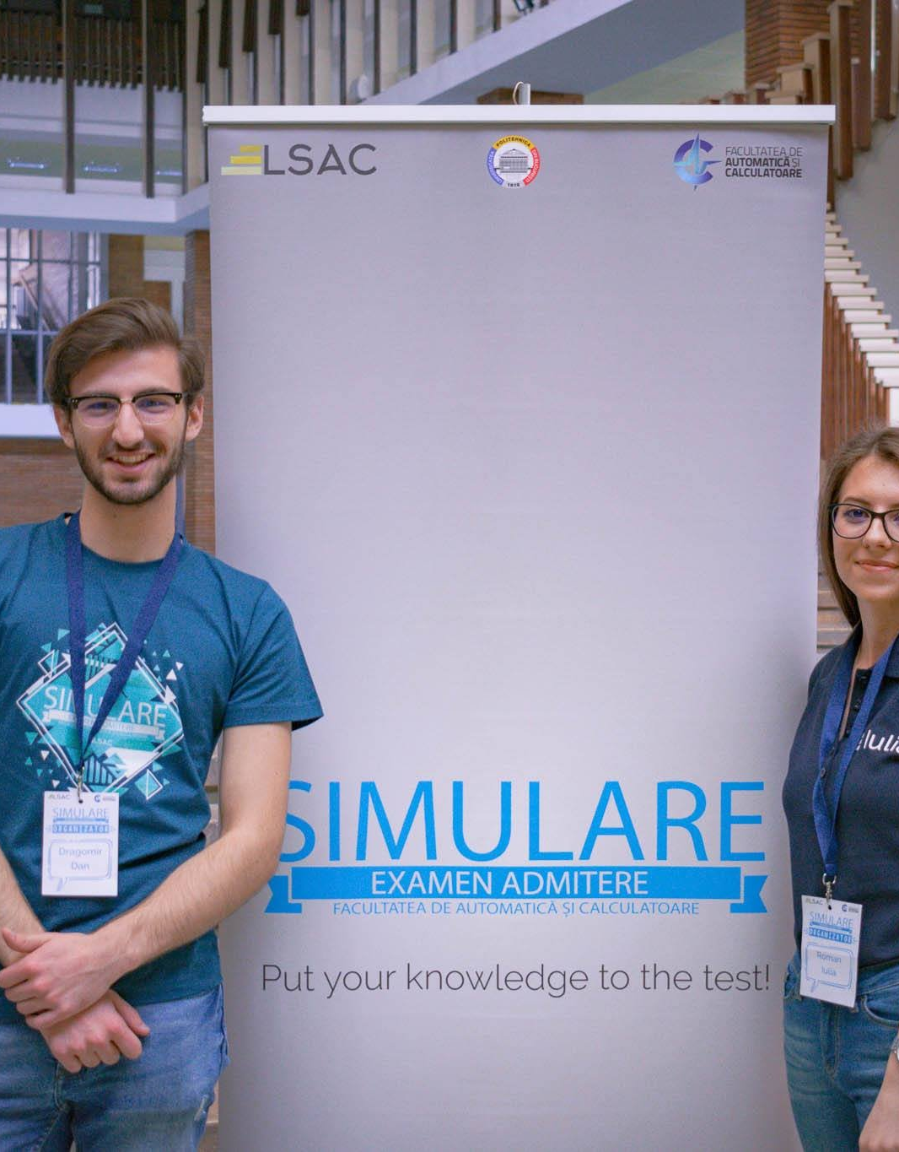









SAMPLE
/LsacBucuresti
lsacbucuresti.ro
Volunteering
Notes:
//presenter: student
Insert relevant pictures from volunteering events or NGOs that are being organized in your HEI

Slide 23
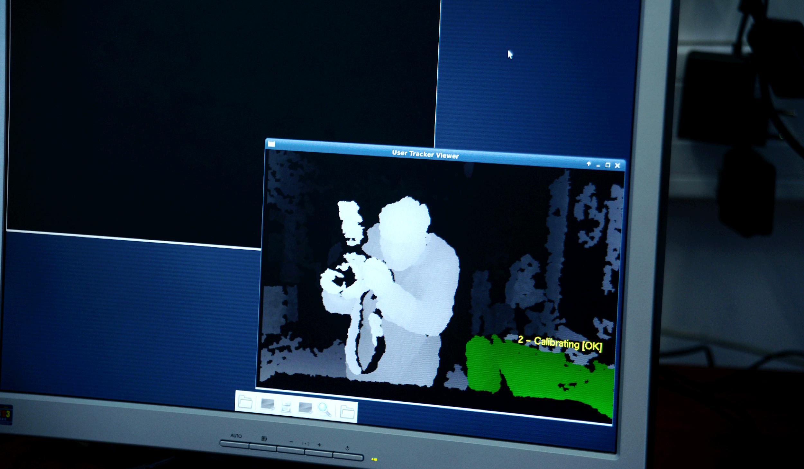
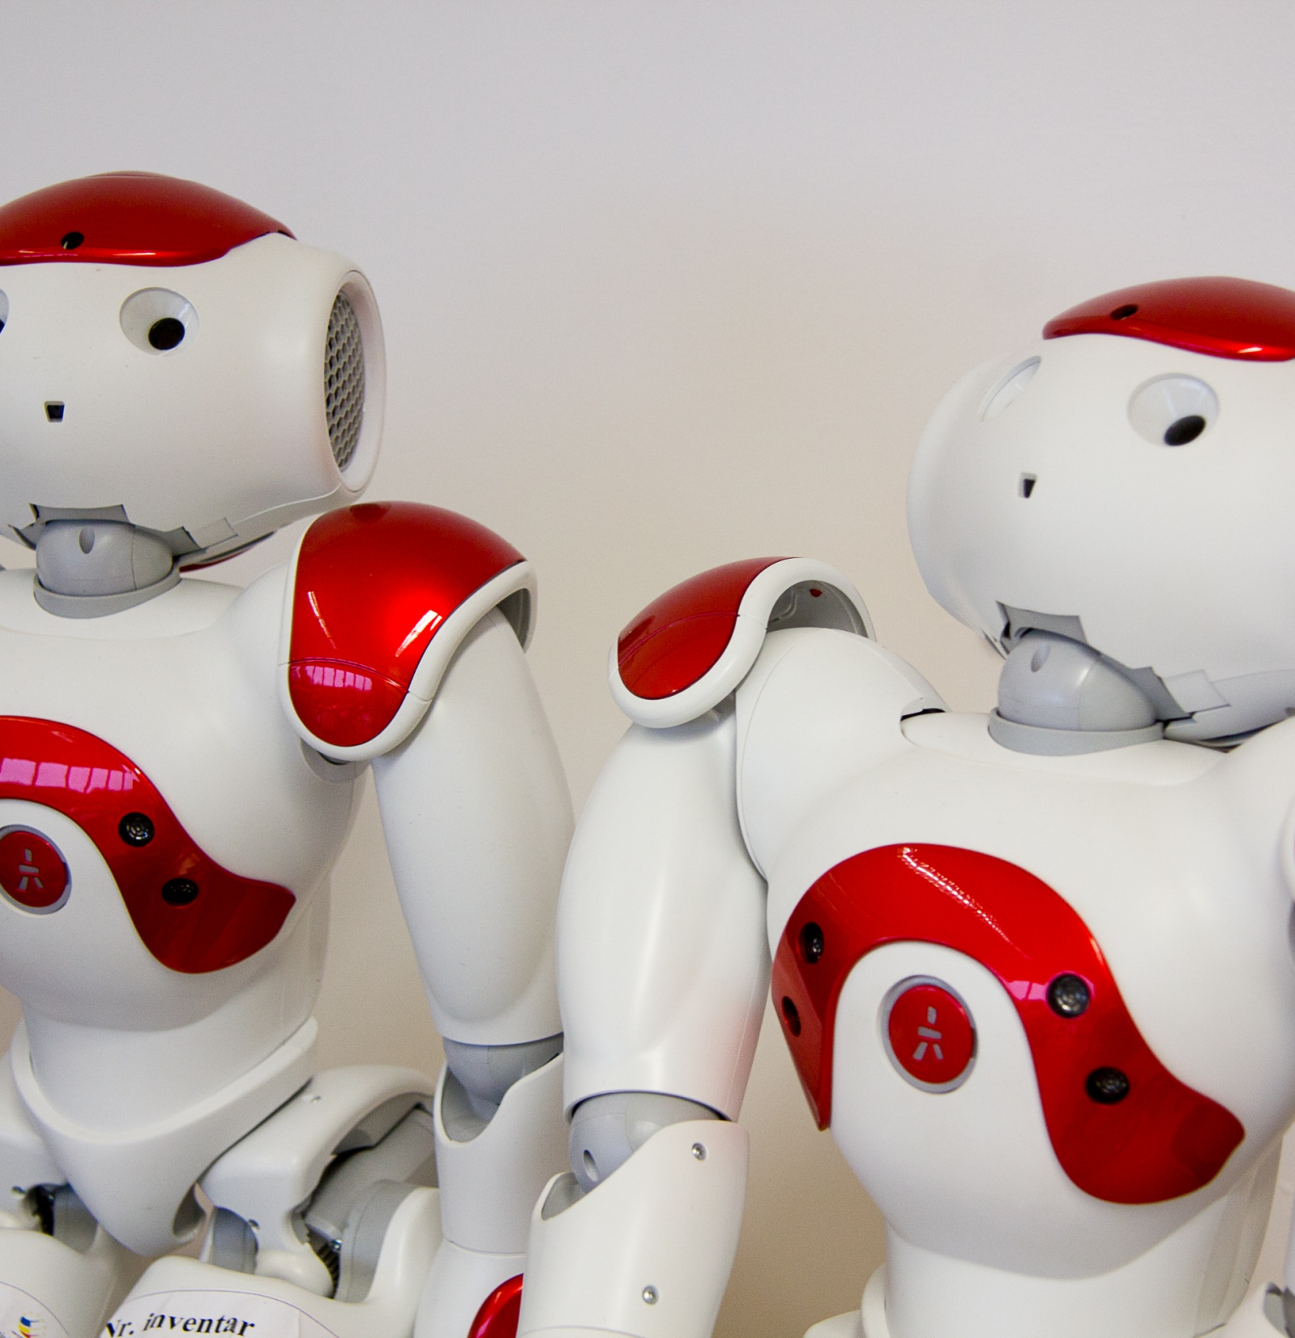
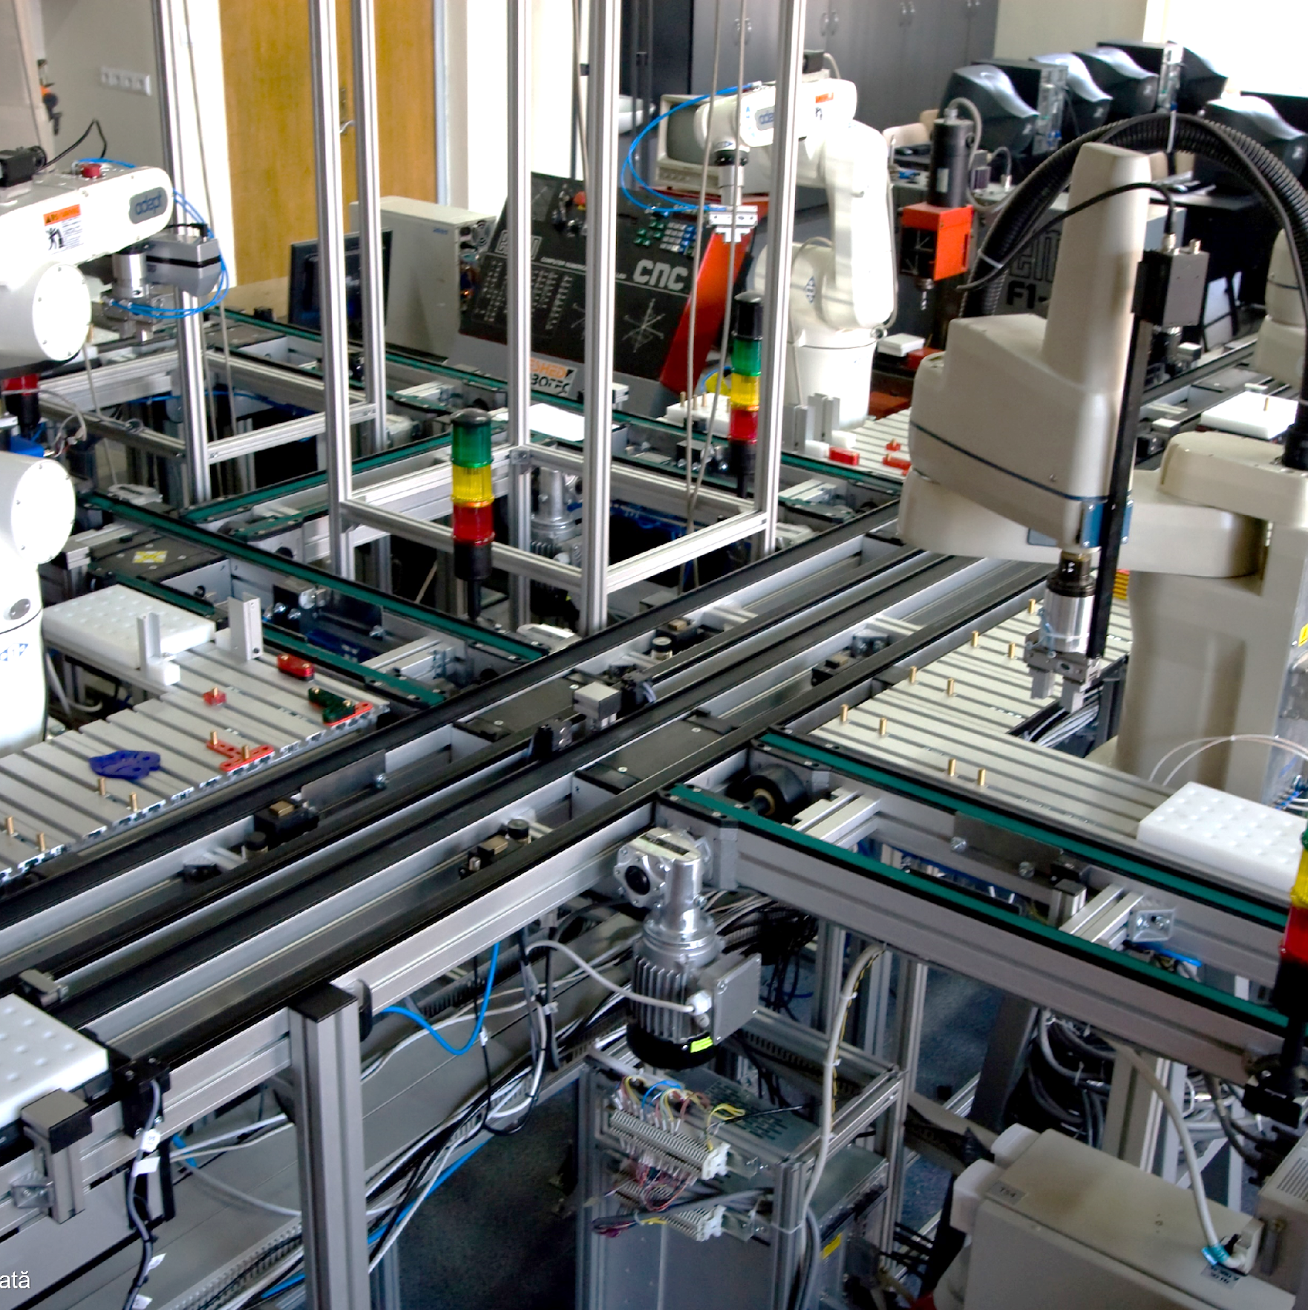
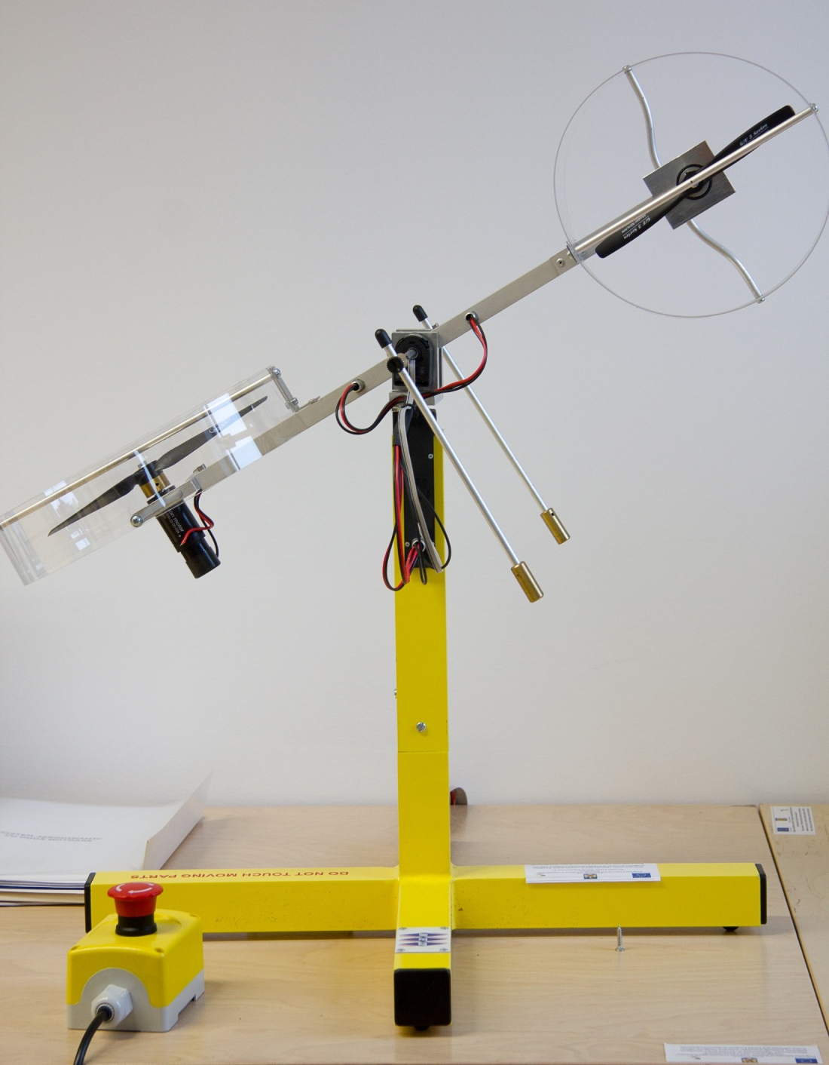
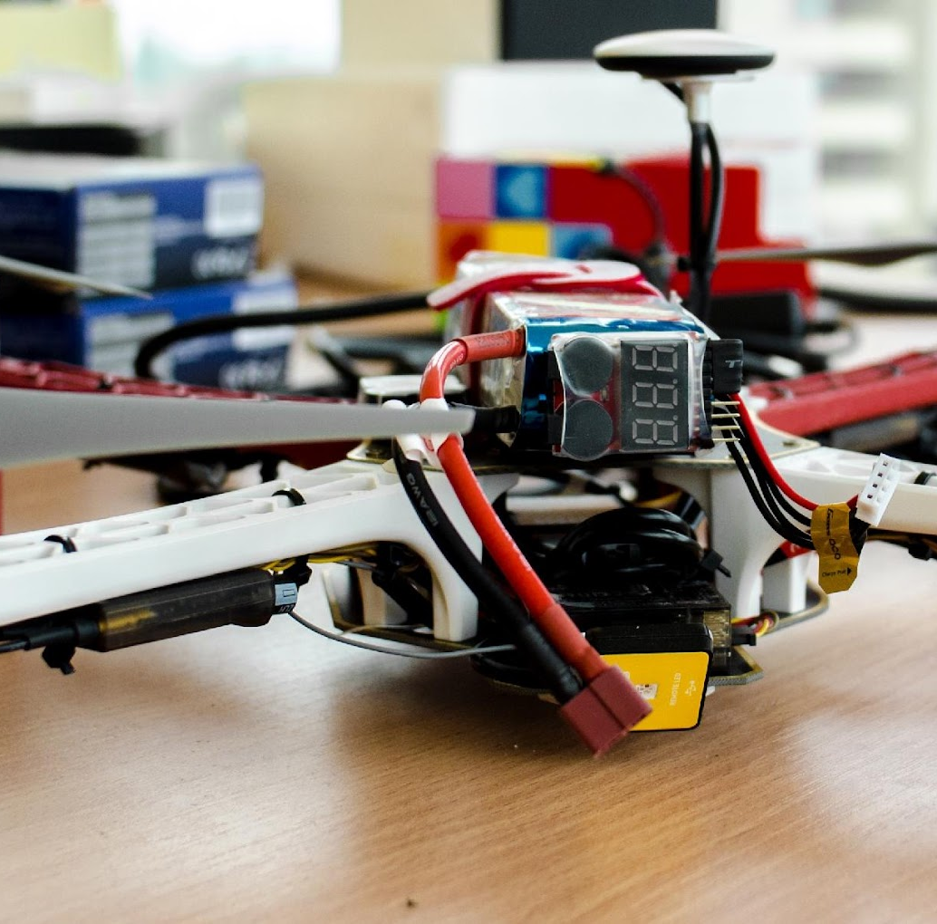
SAMPLE
Research labs
Research projects
Notes:
//presenter: teacher
Insert relevant pictures from research facilities or labs that are in your HEI
Duplicate as needed

Slide 24
Opportunities in [Country/City] for
[HEI + Programme(s)] graduates
HEI LOGO
TOP HIRING COMPANIES HERE
Notes:
Optional Some examples of companies in IT&C & Automation – focusing on more well-known companies.
Depending on the audience – support questions such as: How many such companies that hire <HEI> graduates do you think there are in <country>? Do you think there are more or fewer job opportunities than graduates? What job do you think you could have at these companies? If the answer is 'programmer' – provide other examples: IT Architect, Technical Leader, DevOps Infrastructure Architect, Platform Integration Engineer, Advanced Project Engineer, Data Science Manager, Technical Project Leader for Instrument Clusters, Hardware Project Leader, Rapid Prototyping SW Developer/Architect, 5G Protocol Engineer, DevOps Automation Engineer, QA Software Engineer – etc.

Slide 25










































Opportunities in IT&C & Automation in Romania
SAMPLE
Notes:
Optional Some examples of companies in IT&C & Automation – focusing on more well-known companies.
Depending on the audience – support questions such as: How many such companies that hire <HEI> graduates do you think there are in <country>? Do you think there are more or fewer job opportunities than graduates? What job do you think you could have at these companies? If the answer is 'programmer' – provide other examples: IT Architect, Technical Leader, DevOps Infrastructure Architect, Platform Integration Engineer, Advanced Project Engineer, Data Science Manager, Technical Project Leader for Instrument Clusters, Hardware Project Leader, Rapid Prototyping SW Developer/Architect, 5G Protocol Engineer, DevOps Automation Engineer, QA Software Engineer – etc.

Slide 26
Admission
Notes:
The next slides should be focused on how to get admitted to your HEI ☺

Slide 27
Thank you! [Insert HEI name here]
[Insert HEI logo here]
[Insert HEI website, email, socials, QR code here]
Notes:
Final slide: - Logo
QR Code
Relevant links for your HEI/faculty

